Slide 1

Food Security Prediction

Slide 2
Introduction
In 2018 alone, more than 113 milion people across 53 countries faced crisis levels of acute food insecurity or worse.
Need to build a model that could timely help to better plan and prepare for emerging food security crisis.
World Food Programme (WFP) and ISI Foundation are joining forces to develop a model to forecast the evolution of food security-related indicators (endogenous data sources) collected from household telephone surveys.
Food Consumption Score
(FCS)
Reduced Coping Strategy Index (rCSI)

Slide 3

DATA
SOURCES

Slide 4
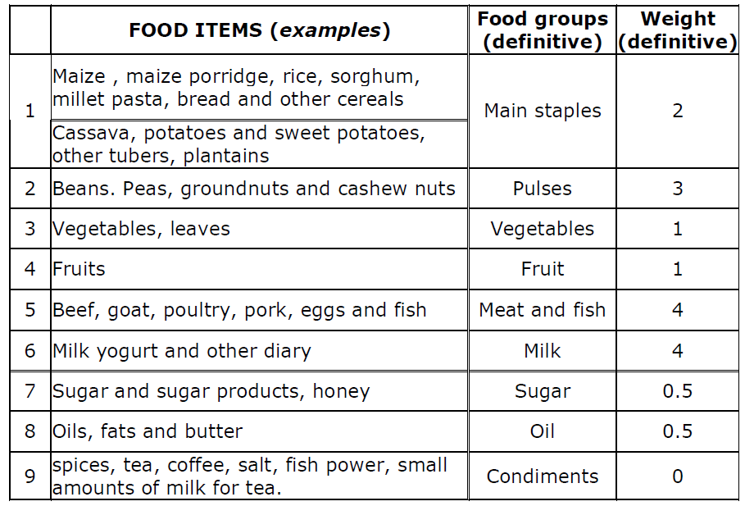
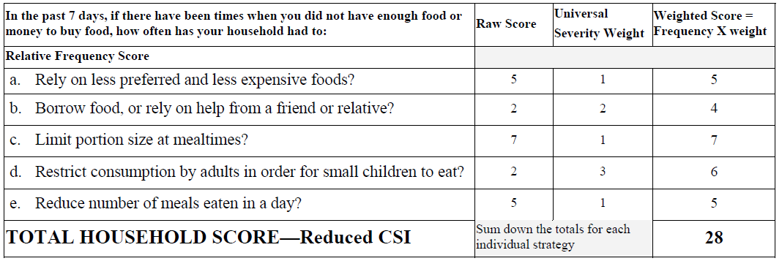
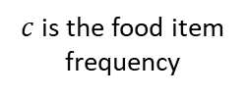
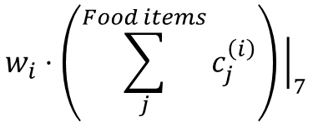
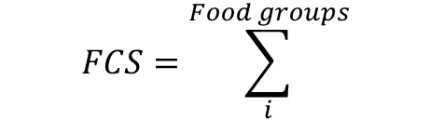
Food Consumption Score
Reduced Coping Strategy Index
“I would like to ask you about all the different foods that your household members have eaten in the last 7 days. Could you please tell me how many days in the past week your household has eaten the following foods?”
“What do you do when don't have adeguate food, and don't have the money to buy food?”
$$FCS=\sum_{i}^{Food groups}{ }$$
$$w_{i}⋅\left(\sum_{j}^{Food items}{c_{j}^{\left(i\right)}}\right){\left.​\right|}_{7}$$
$c$is the food item frequency
Summarising, the rCSI is a proxy indicator to monitor the adopted behaviour by households if they encounter a food shortages in the past 7 days from the survey.
Definition of three groups: poor, borderline, acceptable.
< 21
> 35
poor
borderline
acceptable

Slide 5
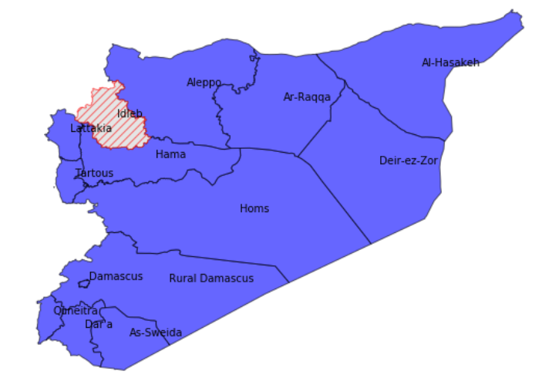
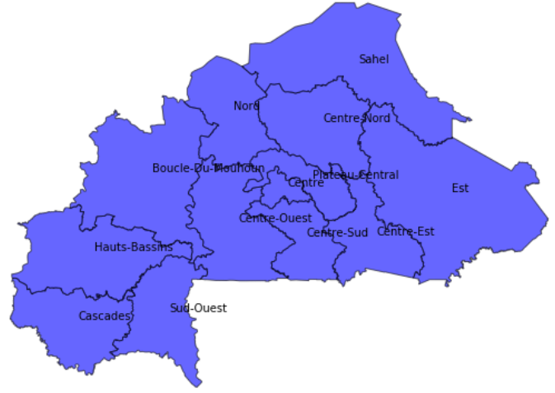
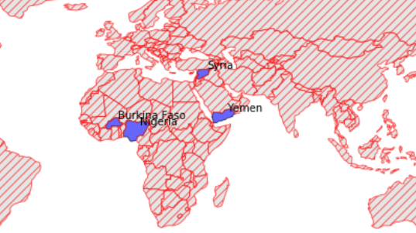
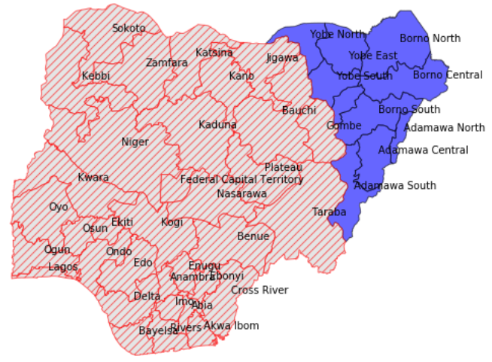
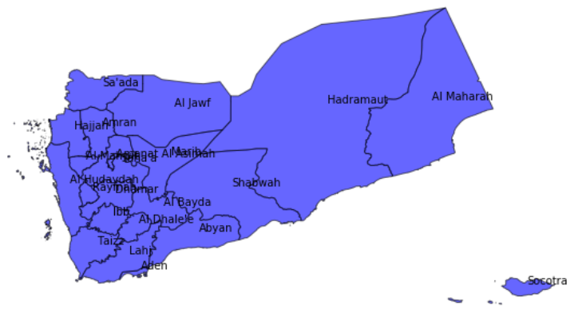
Where these surveys are conducted?
The data with which the indicators are built cover four countries: Nigeria, Burkina Faso, Syria and Yemen.
In each of these countries, the surveys are conducted at provincial (or sub-provincial) level

Slide 6
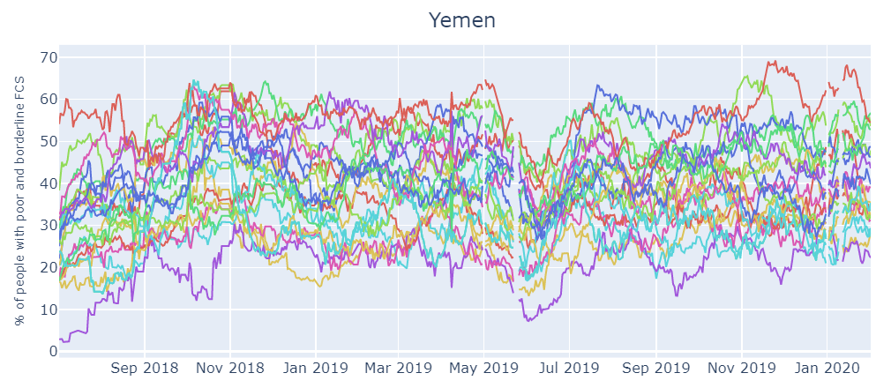
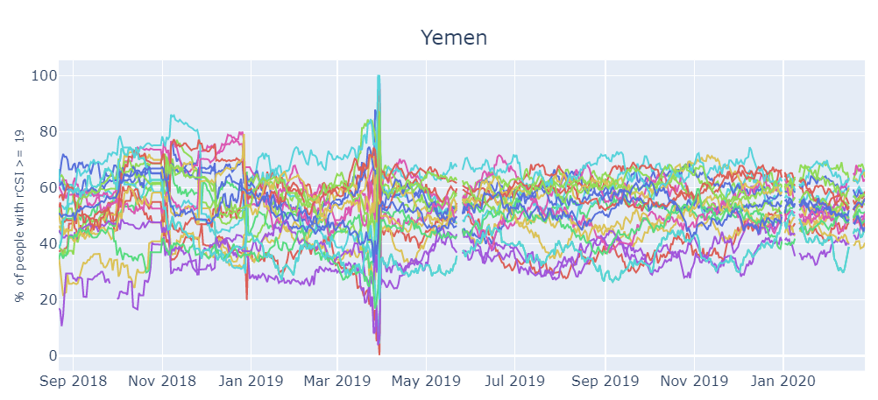
Data are daily time-series at the provincial level:
Example:
rCSI
FCS
The reference periods of the FCS time-series:
Nigeria: Jan 18, 2019 - Feb 3, 2020
Syria: Aug 31, 2018 - Feb 2, 2020
Burkina Faso: Sep 8, 2019 - Feb 3, 2020
Yemen: Jul 2, 2018 - Feb 1, 2020
The reference periods of the rCSI time-series:
Nigeria: May 25, 2019 - Feb 29, 2020
Syria: Aug 31, 2018 - Feb 27, 2020
Burkina Faso: Sep 8, 2019 - Feb 29, 2020
Yemen: Aug 22, 2018 - Feb 26, 2020

Slide 7
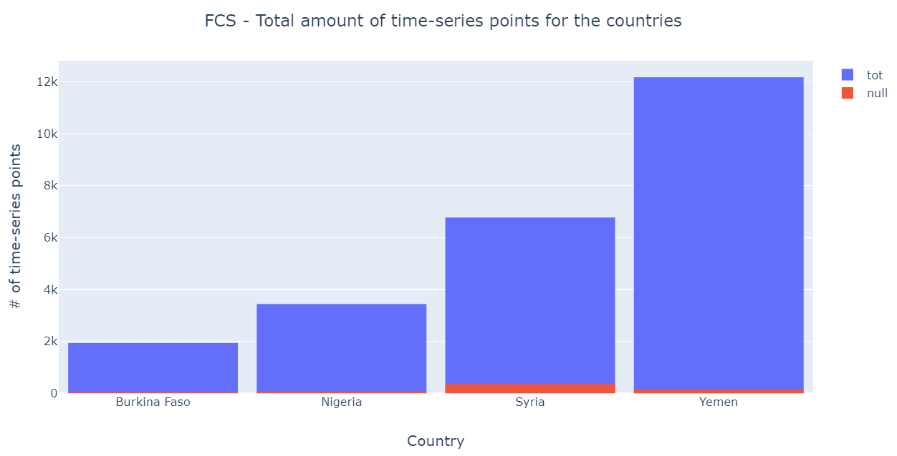
Why Yemen?
Having to study the underlying causes of the food security based on these indicators, it makes sense to first consider each country indipendently:
Are the reasons that influence food security different from country to country or even from province to province?

Slide 8
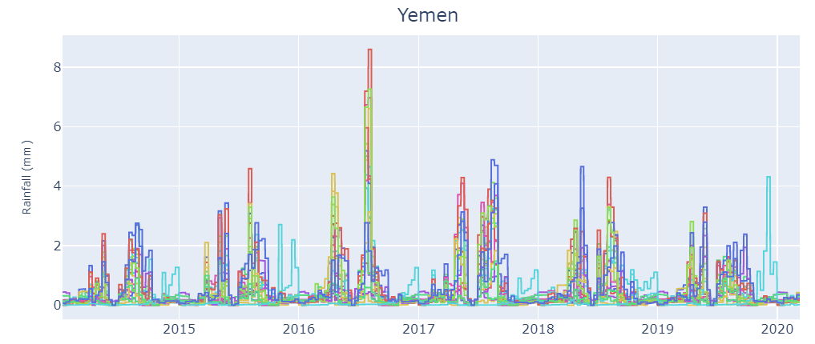
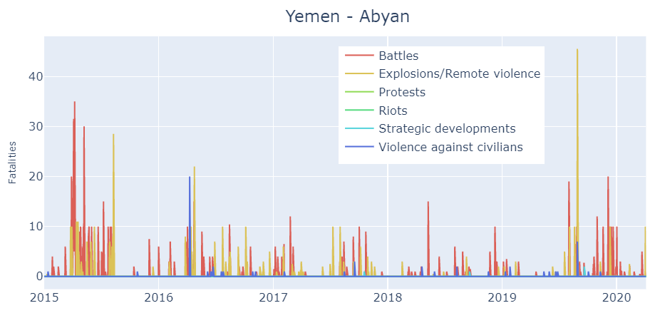
Exogenous Data Sources
Integration of additional exogenous data sources into the model allow to improve the effectiveness and accuracy of the forecast of the endogenous data sources.
CONFLICTS: daily time-series
RAINFALL & VEGETATION: 10-days time-series
ACLED codes six types of events, both violent and non-violent, that may occur during a conflict.
To resample at daily level, the dekad amount of precipitations are equally divided between the days of the dekad.
Example:
Similarly, the NDVI index time-series describe the density of green on a patch of land.

Slide 9
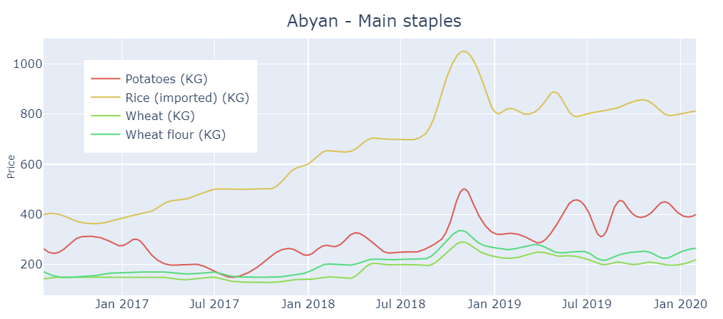
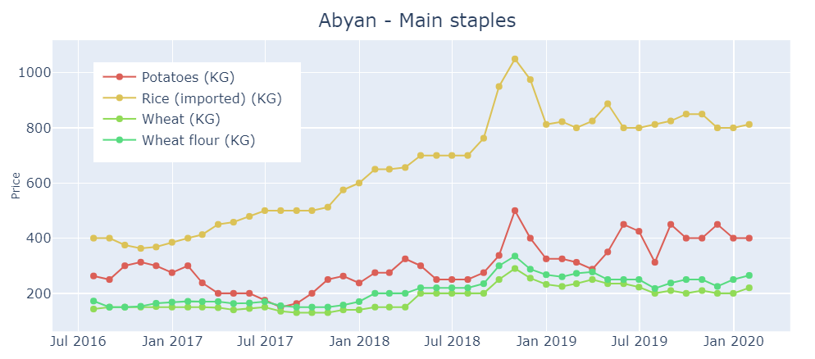
MARKET PRICES: monthly time-series
These data released by WFP regard the price of some food and no food commodities (e.g. Maize, Rice, Tomatoes, Beans, Pasta, Fuel, Wage, etc.):
Some commodities are not uniformly present (data not available) for all provinces;
Some commodities are measured over time with different units type (KG, MT, L, etc.);
The commodities are grouped according to the Food Consumption Score survey: Main staples, Condiments, Exchange rate, Fuel, Meet, fish and eggs, Pulses, Oil, Milling cost, Sugar, Vegetables, Wage
Example:
Finally, averaged to unique time-series group!
Interpolation at daily level using a polynomial interpolation of 2° order

Slide 10
ANALYSIS DATA

Slide 11
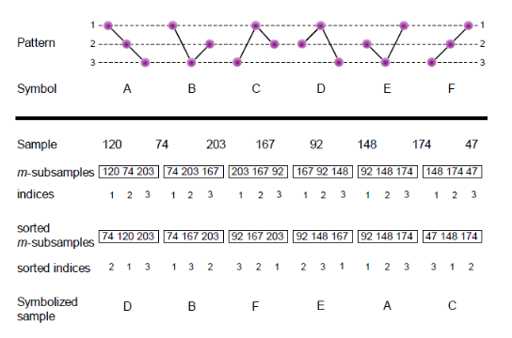
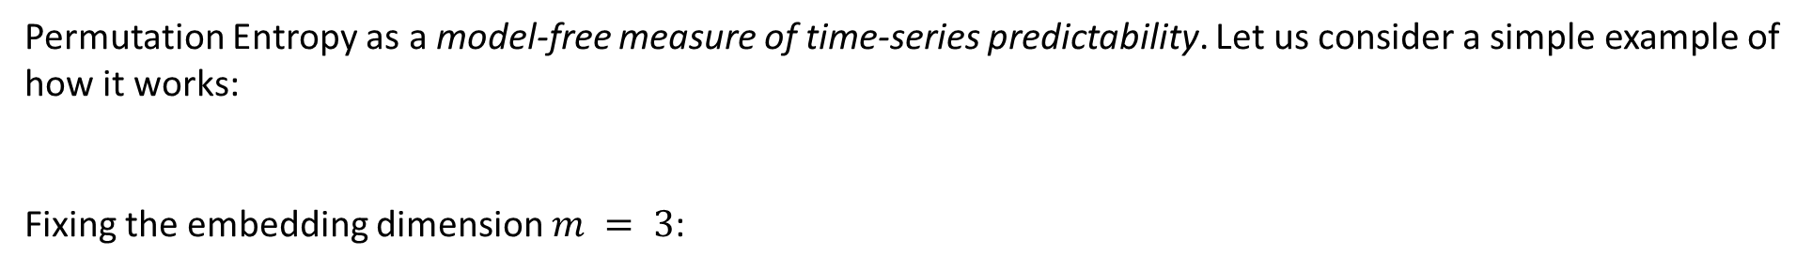
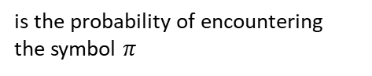
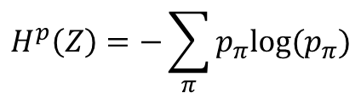
Permutation entropy^{[1]}
Permutation Entropy as a model-free measure of time-series predictability. Let us consider a simple example of how it works:
Fixing the embedding dimension $m = 3$:
$$Z=\{120, 74, 203, 167, 92, 148, 174, 47\}$$
The permutation entropy (PE) of the time-series is given by the Shannon entropy of symbolic time-series:
$$H^{p}\left(Z\right)=−\sum_{π}{p_{π}log⁡(p_{π})}$$
is the probability of encountering the symbol $π$
[1]. "On the predictability of infectious disease outbreaks", Samuel V. Scarpino & Giovanni Petri.

Slide 12
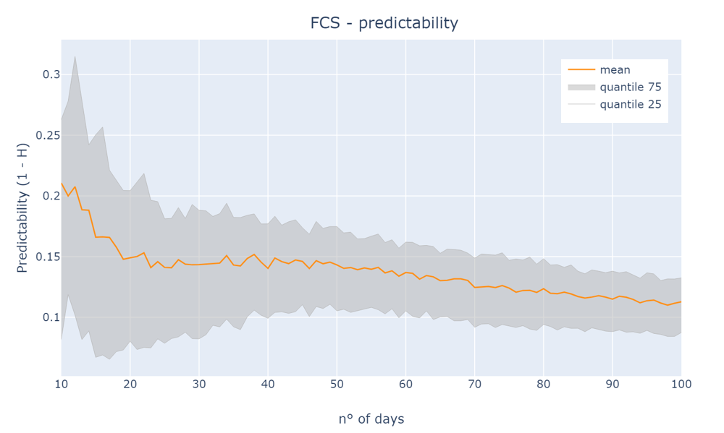
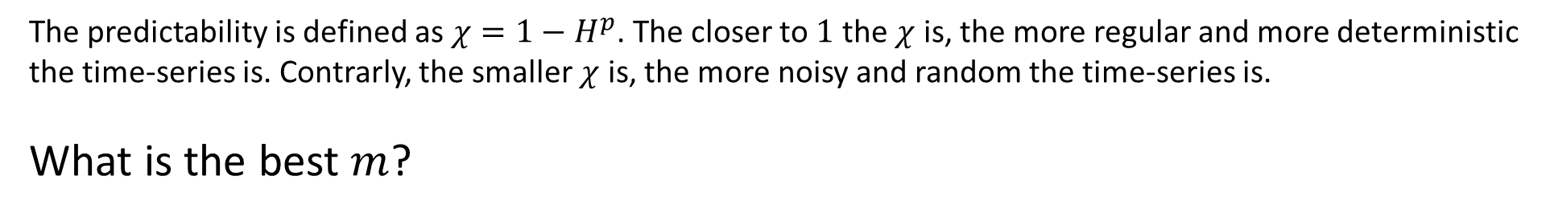

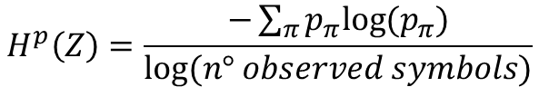
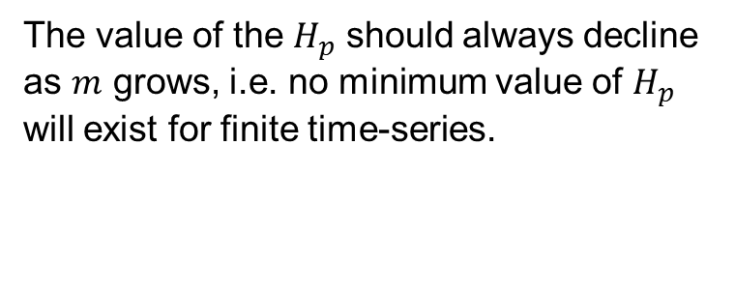
The predictability is defined as $χ=1−H^{p}$. The closer to $1$ the $χ$ is, the more regular and more deterministic the time-series is. Contrarly, the smaller $χ$ is, the more noisy and random the time-series is.
What is the best $m$?
It encodes the fundamental temporal unit of predictability
The value of the $H_{p}$ should always decline as $m$ grows, i.e. no minimum value of $H_{p}$ will exist for finite time-series.
$$H^{p}\left(Z\right)=\frac{−\sum_{π}{p_{π}log⁡(p_{π})}}{log⁡(n° observed symbols)}$$
Exist a minimum of $H_{p}$ varying $m$!

Slide 13
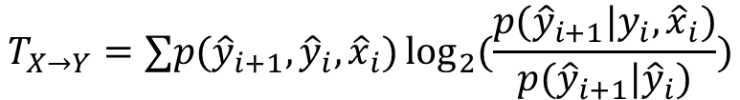
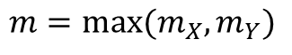
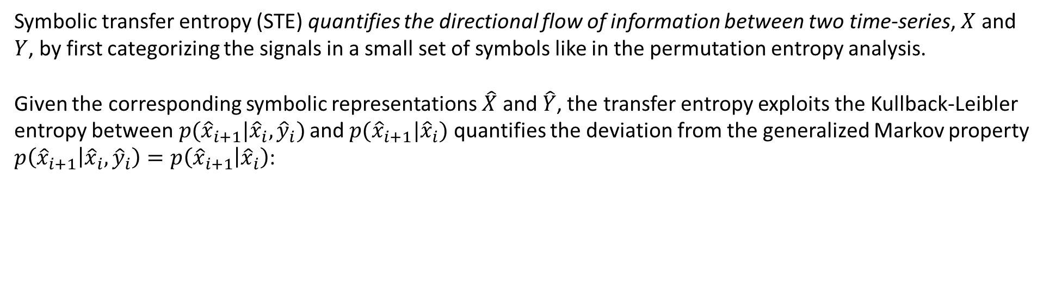
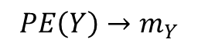
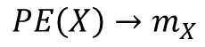
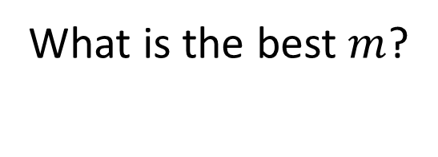
Symbolic transfer entropy^{[2]}
Symbolic transfer entropy (STE) quantifies the directional flow of information between two time-series, $X$ and $Y$, by first categorizing the signals in a small set of symbols like in the permutation entropy analysis.
Given the corresponding symbolic representations $\hat{X}$ and $\hat{Y}$, the transfer entropy exploits the Kullback-Leibler entropy between$p({\hat{x}}_{i+1}|{\hat{x}}_{i}, {\hat{y}}_{i})$ and $p({\hat{x}}_{i+1}|{\hat{x}}_{i})$ quantifies the deviation from the generalized Markov property $p\left({\hat{x}}_{i+1} | {\hat{x}}_{i}, {\hat{y}}_{i}\right)=p\left({\hat{x}}_{i+1} | {\hat{x}}_{i}\right)$:
$$T_{X→Y}=∑p({\hat{y}}_{i+1}, {\hat{y}}_{i}, {\hat{x}}_{i})\log_{2}{(\frac{p({\hat{y}}_{i+1}|y_{i}, {\hat{x}}_{i})}{p({\hat{y}}_{i+1}|{\hat{y}}_{i})})}$$
asymmetric!
What is the best $m$?
$$PE\left(X\right)→m_{X}$$
$$m=max⁡(m_{X}, m_{Y})$$
$$PE\left(Y\right)→m_{Y}$$
[2]. "The dynamics of information-driven coordination phenomena: A transfer entropy analysis", Javier Borge-Holthoefer, Nicola Perra, Bruno Gonçalves, Sandra González-Bailón, Alex Arenas, Yamir Moreno, Alessandro Vespignani.

Slide 14
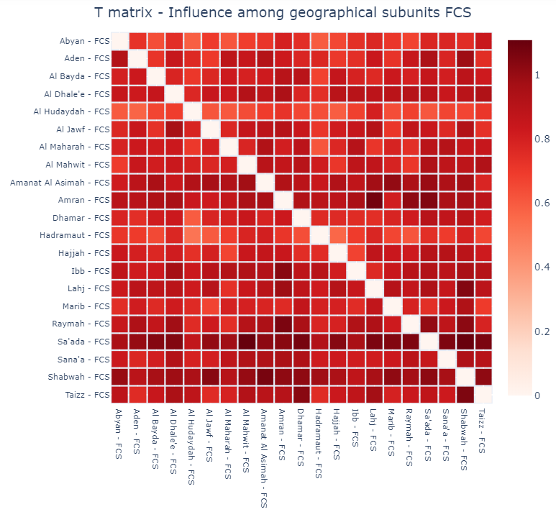
Some analysis…
Influence among different geographical subunits of the FCS indicator (weekly resampled): encoding the role of each geographical subunit, a sort of "who steers whom“:

Slide 15
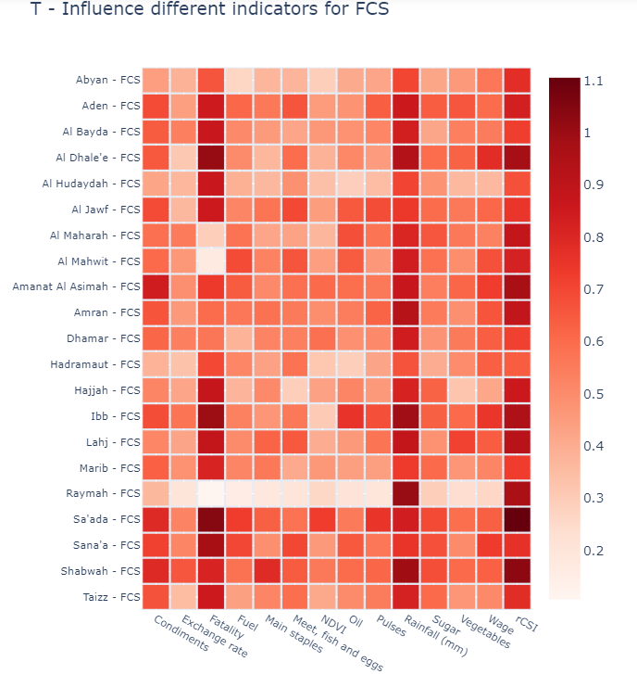
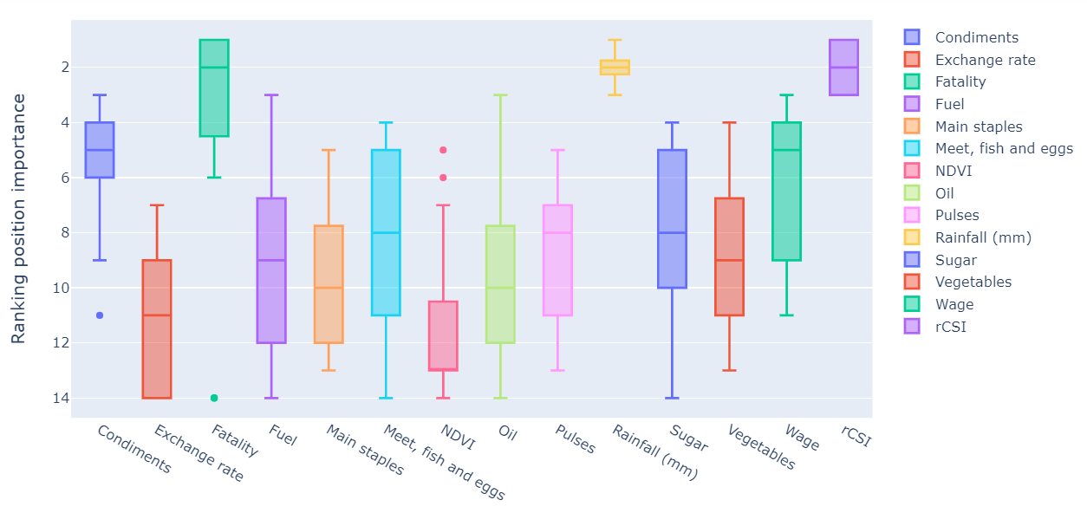
Through the STE, we look for which indicator, between FCS and rCSI, influences the other the most within the same province counting the times that indicator A is influenced by indicator B more than he influences indicator B:
Now, consider each province as an indipendently group and look for the information flow that the exogenous data sources proper to that province give to their respective FCS indicator:

Slide 16
FORECASTING

Slide 17
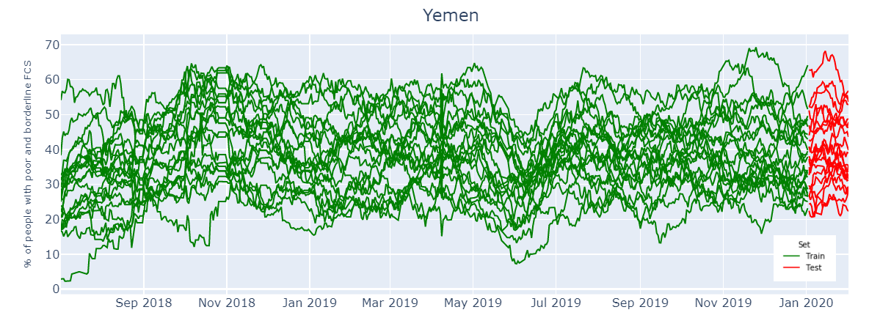

Goal reminding
Need to build a model that could forecast the food security indicators, in particular the Food Consumption Score (FCS), of each province of the Yemen country.
Train: 550 points per province
Prediction horizon:
$h = 30$days
Jul 2, 2018 - Feb 1, 2020
Test: 30 points per province

Slide 18
It is important and useful to test simple forecast strategies prior to testing more complex ones. First of all, a distinction must be made regarding the type of forecast:
UNIVARIATE FORECASTING: forecast each FCS time-series using only the past values of the same time-series;
MULTIVARIATE FORECASTING: forecast each FCS time-series using either the information of other FCS time-series or the trends of exogenous indicators;
Each of these approaches try to forecast the time-series using different models, also in this case starting from the simplest up to increasing the model complexity. A main distinction can be made into two groups:
Statistical models: prior knowledge about the data distribution;
Machine learning models: no prior knowledge of data distribution;
baseline in performance

Slide 19
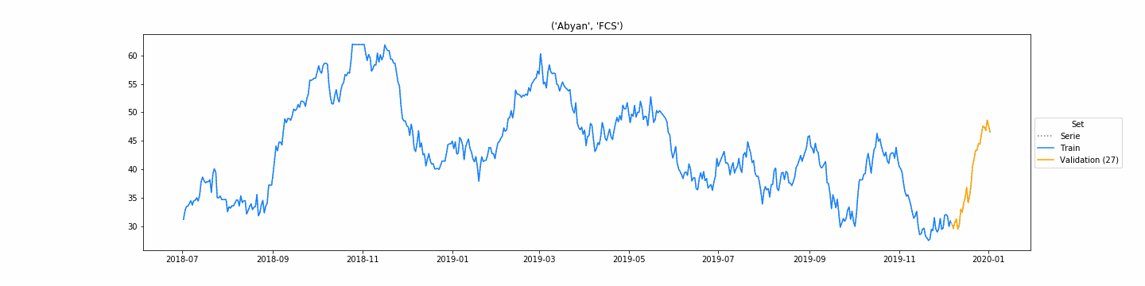
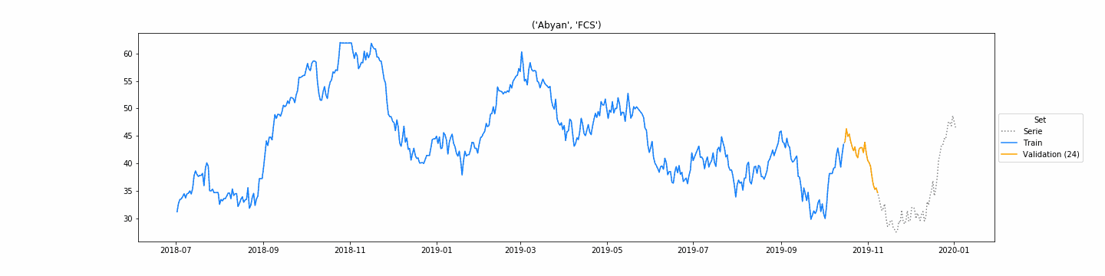
The functionality of each model, both statistical and machine learning, is characterized by the setting of some parameters. How to choose them?
A grid search operation can help us…
Holdout validation:
K-fold cross validation:
We choose this type of validation for the statistical models!

Slide 20
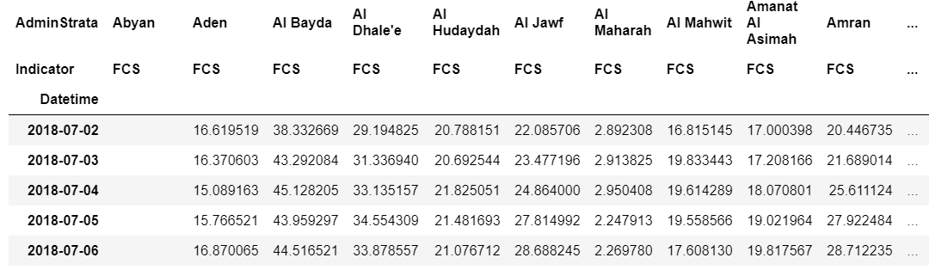






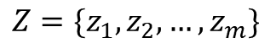
UNIVARIATE FORECASTING
$$Z$$
$$z_{1}$$
$$z_{2}$$
$$z_{3}$$
$$z_{4}$$
$$z_{5}$$
$$Z=\{z_{1},z_{2},…, z_{m}\}$$
Statistical models:
Machine learning models:
Naive;
Simple Moving Average (SMA);
Simple Exponential Smoothing (SES);
Holt's Exponential Smoothing (HES);
Holt-Winters' Seasonal Exponential Smoothing (HW);
Autoregressive (AR);
Autoregressive Integrated Moving Average (ARIMA);
kNN-TSPI;
Support Vector Machine (SVM);
Multi Layer Perceptron (MLP);
LSTM;
CNN-LSTM;

Slide 21
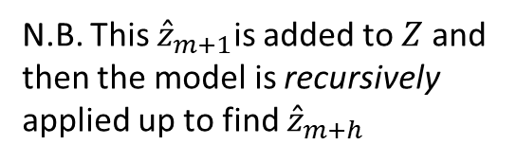
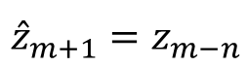
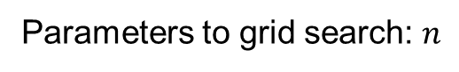
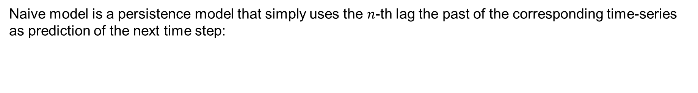
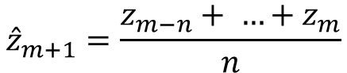
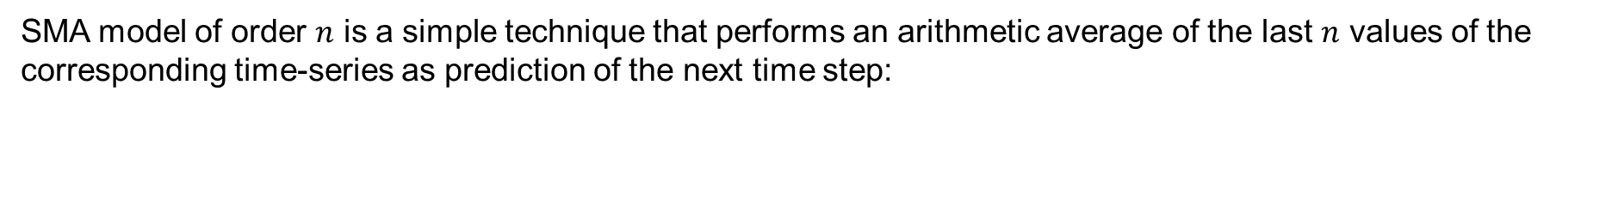
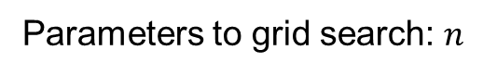
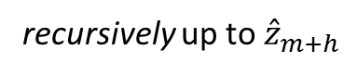
NAIVE model
Naive model is a persistence model that simply uses the $n$-th lag the past of the corresponding time-series as prediction of the next time step:
N.B. This ${\hat{z}}_{m+1}$is added to $Z$ and then the model is recursively applied up to find ${\hat{z}}_{m+h}$
$${\hat{z}}_{m+1}=z_{m−n}$$
Parameters to grid search: $n$
SMA model
SMA model of order $n$ is a simple technique that performs an arithmetic average of the last $n$ values of the corresponding time-series as prediction of the next time step:
$${\hat{z}}_{m+1}=\frac{z_{m−n}+ …+z_{m}}{n}$$
recursively up to ${\hat{z}}_{m+h}$
Parameters to grid search: $n$

Slide 22
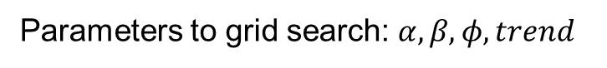
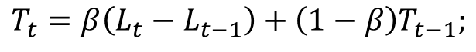
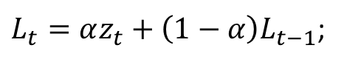












SES model
$${\hat{z}}_{m+1}={αz}_{m}+α\left(1−α\right)z_{m−1}+ … +α{\left(1−α\right)}^{m−1}z_{1}$$
The SES method is a weighted SMA: the weights increase exponentially over time so that the most recent observations exert more influence on the calculation of future predictions.
Stationarity, No trend and no seasonality
C.I.
$L_{t}=αz_{t}+\left(1−α\right)L_{t−1}$;
$$L_{1}=z_{1}$$
${\hat{z}}_{m+1}=L_{m}$
recursively up to ${\hat{z}}_{m+h}$
additive trend
Parameters to grid search: $α$
C.I.
$L_{t}=αz_{t}+\left(1−α\right)(L_{t−1}+{φT}_{t−1})$;
HES model
$$L_{1}=z_{1}$$
$$T_{t}=β\left(L_{t}−L_{t−1}\right)+\left(1−β\right)T_{t−1};$$
Stationarity, trend and no seasonality
$$T_{1}=z_{2}−z_{1}$$
${\hat{z}}_{m+h}=L_{m}+h(\sum_{i=1}^{h}{φ^{i}})T_{m}$
Parameters to grid search: $α, β, φ, trend$
additive trend and additive season
HW model
$L_{t}=α{(z}_{t}−S_{t−s})+\left(1−α\right)(L_{t−1}+{φT}_{t−1})$;
C.I.
Level
Trend
Seasons
Stationarity, trend and seasonality
$$T_{t}=β\left(L_{t}−L_{t−1}\right)+\left(1−β\right){φT}_{t−1};$$
Parameters to grid search: $α, β, γ,φ, trend,$
$season$
$$S_{t}=γ\left(z_{t}−L_{t−1}−φT_{t−1}\right)+\left(1−γ\right)S_{t−s};$$
${\hat{z}}_{m+h}=L_{m}+h\left(\sum_{i=1}^{h}{φ^{i}}\right)T_{m}+S_{t−s+1+{\left(h+1\right)}_{mod s}}$

Slide 23



AR model
Autoregression is a time-series model that uses $p$-last observations from previous time steps as input to a regression equation to predict the value at the next time step:
where $b_{0}, b_{1}$and $b_{2}$ are coefficients found by optimizing the model on training data.
$${\hat{z}}_{m+1}=b_{0}+b_{p}z_{m−p }+ …+b_{1}z_{m}$$
Parameters to grid search: $p$
ARIMA model
It combines both Autoregression (AR) with p order and Moving Average (MA) with q order models as well as a differencing pre-processing step of the sequence to make the sequence stationary, called integration (I) with d order:
$${\hat{z}}_{m+1}=b_{0}+b_{p}z_{m−p }+ …+b_{1}z_{m}+a_{q}ε_{m−q}+ …{a_{1}ε}_{m}$$
Parameters to grid search: $p, q, d →$ auto_arima model provides an automatic search for best parameters.

Slide 24



kNN-TSPI model
The method searches the $l$ observations, sliding a window, similar to query $Q$. Given $S_{l}^{(1)}, …, S_{l}^{\left(k\right)}$as the $k$ most similar sequence of $Q$. Then, the algorithm uses the next observations of each sequence $S_{l+1}^{(j)}$to predict ${\hat{z}}_{m+1}$:
$$f(S)= \frac{1}{k}\sum_{j=1}^{k}{S_{l+1}^{(j)}}$$
Parameters to grid search: $l$, $k$, complexity measure
SVM model
Support Vector Machine can also be used as a regression method, maintaining all the main features that characterize the algorithm (maximal margin). The main idea is always the same: to minimize error, individualizing the hyperplane which maximizes the margin, keeping in mind that part of the error is tolerated.
Parameters to grid search: serch window $l$, regularization parameter $C$, width $σ$ radial basis function

Slide 25











MLP, LSTM, CNN-LSTM models
$$Z:$$
How to predict $z_{17}, z_{18},z_{19}, z_{20}$?
The sample $z_{12},z_{13}, z_{14}, z_{15},z_{16}$is fed to the trained Neural Network (NN):
$$X$$
$$y$$
$$x_{1}$$
$$x_{2}$$
$$x_{3}$$
$$x_{4}$$
$$x_{5}$$
$$x_{6}$$
$$x_{7}$$
$$x_{8}$$
$$x_{9}$$
$$x_{10}$$
$$y_{1}$$
$$y_{2}$$
$$y_{3}$$
$$y_{4}$$
$$y_{5}$$
$$y_{6}$$
$$y_{7}$$
$$y_{8}$$
$$y_{9}$$
$$y_{10}$$
TrainedNN
NN
Training points
$${(z}_{12},z_{13}, z_{14}, z_{15},z_{16})$$
$${(z}_{14},z_{15}, z_{16},{\hat{z}}_{17},{\hat{z}}_{18})$$
$${\hat{z}}_{17},{\hat{z}}_{18}$$
$${\hat{z}}_{19},{\hat{z}}_{20}$$
RECURSIVE APPROACH

Slide 26









$$Z:$$
How to predict $z_{17}, z_{18},z_{19}, z_{20}$?
The sample $z_{12},z_{13}, z_{14}, z_{15},z_{16}$is fed to the trained Neural Network (NN):
$$X$$
$$y$$
TrainedNN
NN
$$x_{1}$$
$$x_{2}$$
$$x_{3}$$
$$x_{4}$$
$$x_{5}$$
$$x_{6}$$
$$x_{7}$$
$$x_{8}$$
$$y_{1}$$
$$y_{2}$$
$$y_{3}$$
$$y_{4}$$
$$y_{5}$$
$$y_{6}$$
$$y_{7}$$
$$y_{8}$$
Training points
$${(z}_{12},z_{13}, z_{14}, z_{15},z_{16})$$
$${\hat{z}}_{17},{\hat{z}}_{18},{\hat{z}}_{19},{\hat{z}}_{20}$$
DIRECT APPROACH

Slide 27









The validation phase for these models is a bit different:
No shuffle $≈$
holdout validation
Shuffle
$$X$$
$$y$$
$$X$$
$$y$$
$$x_{1}$$
$$x_{2}$$
$$x_{3}$$
$$x_{4}$$
$$x_{5}$$
$$x_{6}$$
$$x_{7}$$
$$x_{8}$$
$$x_{9}$$
$$x_{10}$$
$$y_{1}$$
$$y_{2}$$
$$y_{3}$$
$$y_{4}$$
$$y_{5}$$
$$y_{6}$$
$$y_{7}$$
$$y_{8}$$
$$y_{9}$$
$$y_{10}$$
$$x_{1}$$
$$x_{2}$$
$$x_{3}$$
$$x_{4}$$
$$x_{5}$$
$$x_{6}$$
$$x_{7}$$
$$x_{8}$$
$$x_{9}$$
$$x_{10}$$
$$y_{1}$$
$$y_{2}$$
$$y_{3}$$
$$y_{4}$$
$$y_{5}$$
$$y_{6}$$
$$y_{7}$$
$$y_{8}$$
$$y_{9}$$
$$y_{10}$$
Training points
Training points
validation set

Slide 28



















MULTIVARIATE FORECASTING
$$Z$$
$$E$$
$$V$$
$$z_{1}$$
$$e_{1}$$
$$v_{1}$$
$$z_{2}$$
$$e_{2}$$
$$v_{2}$$
$$z_{3}$$
$$e_{3}$$
$$v_{3}$$
$$z_{4}$$
$$e_{4}$$
$$v_{4}$$
$$z_{5}$$
$$e_{5}$$
$$v_{5}$$
If necessary, shift delay! E.g. food prices 30 days
The indicators for each province are the following:
FCS, rCSI, Condiments, Exchange rate, Fatality, Fuel, Main staples, Meet, fish and eggs, NDVI, Oil, Pulses, Rainfall, Sugar, Vegetables, Wage
Machine learning models:
CNN-LSTM;

Slide 29





Define $P = \left\{Abyan, Aden, …, Taizz\right\}$as the set of all the provinces of Yemen: each single province $p$ is described by associated FCS. Assuming a recursive forecast strategy:
$$∀ p∈P p:$$
Each province will get its own set of training points $\left({\vec{X}}^{p}, {\vec{y}}^{p}\right)$. All these points are put together into a single pot that feed a single neural network :
NN
Trained NN
$$({\vec{X}}^{Abyan}, {\vec{y}}^{Abyan})$$
$$({\vec{X}}^{Aden}, {\vec{y}}^{Aden})$$
$$({\vec{X}}^{Taizz}, {\vec{y}}^{Taizz})$$
…
$$({\vec{X}}^{Lahj}, {\vec{y}}^{Lahj})$$

Slide 30







Define $P = \left\{Abyan, Aden, …, Taizz\right\}$as the ensemble of all the provinces of Yemen: each single province $p$ is described by the associated time-series (endogenous and exogenous data sources). Assuming a direct forecast strategy:
$$∀ p∈P p:$$
Each province will get its own set of training points $\left({\vec{X}}^{p}, {\vec{y}}^{p}\right)$. All these points are put together into a single pot that feed a single neural network :
NN
Trained NN
$$({\vec{X}}^{Abyan}, {\vec{y}}^{Abyan})$$
$$({\vec{X}}^{Aden}, {\vec{y}}^{Aden})$$
$$({\vec{X}}^{Taizz}, {\vec{y}}^{Taizz})$$
…
$$({\vec{X}}^{Lahj}, {\vec{y}}^{Lahj})$$

Slide 31


Define $P = \left\{Abyan, Aden, …, Taizz\right\}$as the ensemble of all the provinces of Yemen: each single province $p$ is described by the associated time-series (endogenous and exogenous data sources). Assuming a direct forecast strategy:
$$∀ p∈P p:$$
Each province will get its own set of training points $({\vec{X}}^{p}, {\vec{y}}^{p})$ that independently of each other feed their own neural network:
NN^{Abyan}
Trained NN^{Abyan}
NN^{Taizz}
Trained NN^{Taizz}
…
$$({\vec{X}}^{Abyan}, {\vec{y}}^{Abyan})$$
$$({\vec{X}}^{Taizz}, {\vec{y}}^{Taizz})$$

Slide 32
RESULTS

Slide 33








How measure the accuracy of a prediction?
$$MSE= \frac{1}{h}\sum_{t=1}^{h}{{\left(z_{t}−{\hat{z}}_{t}\right)}^{2}}$$
predicted value
$$MCPM:$$
actual value observed
$$TU= \frac{\sum_{t=1}^{h}{{\left(z_{t}−{\hat{z}}_{t}\right)}^{2}}}{\sum_{t=1}^{h}{{\left(z_{t}−{\hat{z}}_{t−1}\right)}^{2}}}$$
$$MAPE= \frac{1}{h}\sum_{t=1}^{h}{{\left|\frac{{\left(z_{t}−{\hat{z}}_{t}\right)}^{2}}{z_{t}}\right|}^{ }⋅100}$$
$$POCID= \frac{\sum_{t=1}^{h}{D_{t}}}{h}⋅100$$
$$ER=100 − POCID$$
$$D_{t}= \left\{\begin{aligned}1 if \left({\hat{z}}_{t} −{\hat{z}}_{t−1}\right)\left(z_{t}−z_{t−1}\right)>0 \\ 0 otherwise \end{aligned}\right.$$

Slide 34


Slide 35


Slide 36


Slide 37







Slide 38
Conclusion
Best gridsearch;
XGBoost model;
Test resample of the data (weekly, monthly)
Are the reasons that influence food security different from country to country or even from province to province?
NMF, PCA

